Slide 1
Clock it, Check it, Change it
Active Bystander Campaign Toolkit
January 2025

Slide 2
How to use this Toolkit
This toolkit includes:
  Introduction to Clock it, Check it, Change it
  Guidance for re-creating messages
  Key messages
  Links to assets
  Asset samples and sizing
If you have any questions, please contact gary

Slide 3
Introduction
to Active Bystanding

Slide 4
What is active bystanding?
Many people will witness unnacceptable behaviour at some point in their lives. This could entail someone around them engaging in activities such as:
Bullying or harassment
Violence or threatening behaviour
Sexual misconduct
Knife carrying
Discrimination
An active bystander is someone who challenges these behaviours, de-escalating the situation or reducing the harm to the victim(s) either directly (e.g. by intervening in a confrontation) or indirectly (e.g. through reporting the behaviour to the authorities).
Active bystanding is not always our natural response when confronted by unacceptable behaviour. A number of psychological and social factors contribute to many seemingly unacceptable behaviours going unchallenged, especially when these types of situations happen in public; this phenomenon of inactivity is known as the “bystander effect”.
Through challenging the bystander effect and encouraging active bystanding, we can contribute towards a safer and more equitable society, reducing the impact of violence, discrimination and other harmful behaviours.

Slide 5
Our active bystander intervention:
Clock it, Check it, Change it
Because active bystanding as a behaviour is influenced by so many factors, there are a wide range of different approaches to encouraging active bystanding which are capable of delivering positive results.
Our chosen focus for “Clock it, Check it, Change it” as a campaign is on shaping the initial instinct-driven reaction to seeing a distressing or stressful situation – which is often to look away or otherwise ignore it.
This reflexive behaviour is something many of us will have some intuitive understanding of. Perhaps the most famous historical example is found in the biblical Parable of the Good Samaritan; a more contemporary experience might be turning up your headphones to avoid having to listen to an argument or confrontation on public transport.
Science also supports the importance of this reflexive response in determining active bystander behaviours. The unconscious initial perception of an active bystanding situation as distressing plays a significant role in predicting whether an individual goes on to intervene or not.

Slide 6
Our active bystander intervention:
Clock it, Check it, Change it
Luckily, psychological techniques exist which can help us to change negative reflexive reactions. Many of these techniques were originally established as part of Cognitive Behavioural Therapy (CBT) interventions, designed to challenge negative self-thoughts related to anxiety or depression.
“Clock it, Check it, Change it” uses a technique called cognitive restructuring to help our audience of young adults identify and change their thinking when faced with situations where active bystanding could be applied (e.g. a violent confrontation or potential partner abuse).
Specifically, our campaign uses a slightly modified version of the “3C’s” model of cognitive restructuring, which has been shown to work particularly well with children and young people:
Clock it: recognise that you are reflexively looking away from a distressing situation and challenge yourself to take a second look
Check it: think about the ways you might be able to directly or indirectly improve the situation
Change it: be proud of making a positive difference through taking a safe and appropriate action

Slide 7
Implementing “Clock it, Check it, Change it”
“Clock it, Check it, Change it” is designed to be used flexibly across a range of audiences, channels and active bystanding scenarios.
Implementation type 1: Strapline only
Logo lockup:

Slide 8
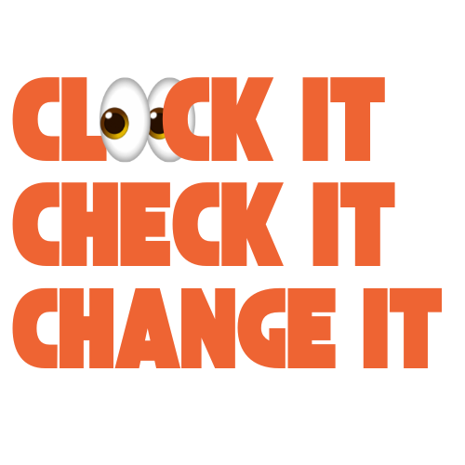
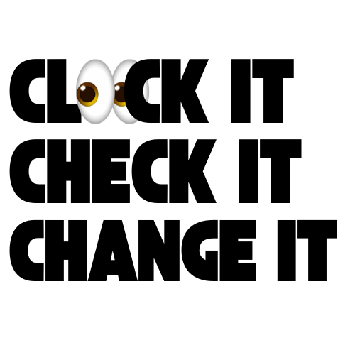
At the centre of all creative activations is the “Clock it, Check it, Change it” strapline. In some instances, this may simply be used as a campaign identifier (for example on educational materials); in this case the simple campaign lock-up could be used in the same way as any other logo.
Logo lockup:

Slide 9
Implementation Type 1
In other cases, the strapline is likely to be accompanied by a simple explanation of each step. This explanation could be generic or tailored to specific scenarios; some examples are shown below:
 | Generic | Violent behaviour | Partner abuse | Knife crime
Clock it | If you see unacceptable behaviour, it’s natural to want to look away | Take another look – could that argument turn violent? | Wishing you hadn’t sat opposite the man shouting at his girlfriend on the train? | Spotted a knife on someone? It’s easy to pretend you never saw it…
Check it | But taking another look can give you the chance to figure out how to help safely | Assessing the situation will give you time to think about safe ways to stop things escalating | Assessing the situation rather than avoiding it could help you figure out how to help | Taking a second look will help you to figure out the best way to help safely – such as reporting them anonymously to the police
Change it | Act with confidence – you have the power to make a positive difference | A simple positive action like asking someone if they’re okay could be enough to avoid them getting hurt | A simple positive action like asking someone if they’re okay could be enough to avoid them getting hurt | Your actions can help reduce the deadly threat of knife crime

Slide 10
Implementation Type 2
For most creative implementations requiring the campaign to grab the attention of the audience (e.g. social media or posters), the second implementation type is most suitable.
For this type of implementation the strapline (with or without additional explanation) is prefaced by a short (1 sentence), punchy narrative that explains the active bystanding scenario. This situational context should:
Use emojis to tell the story of the situation – requiring a “second look” to understand what is actually happening (mimicking the cognitive restructuring approach of the campaign)
Use humour and gently provocative language/emojis to capture attention – these can be dialled up or down depending on the audience and channel (e.g. less provocative language for materials designed for use in schools
Below are some simple examples of how type 2 implementations are brought to life:
“Worried 💩 is about to kick off? Clock it, Check it, Change it”
“Spotted an aggressive W⚓ on the bus? Clock it, Check it, Change it”
“Is your mate being a 🔔🔚 towards his partner? Clock it, Check it, Change it”
In some instances, the creative could also be appended by a secondary call to action (e.g. to visit a website for more information) or by a secondary strapline (e.g. “the standard we ignore is the standard we accept”).

Slide 11
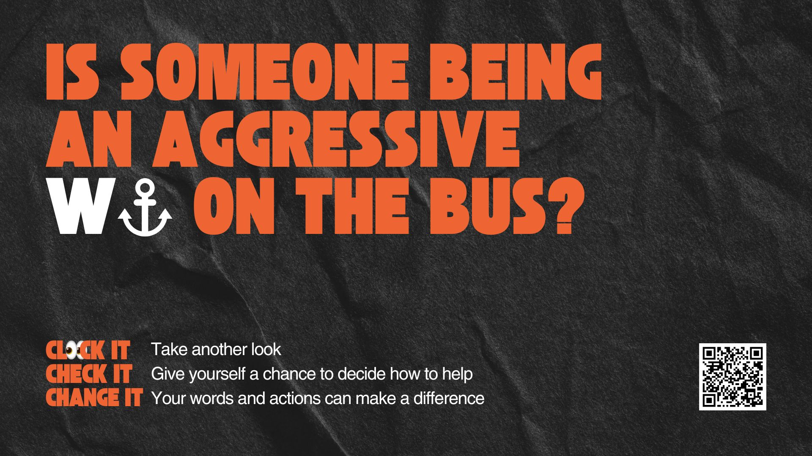
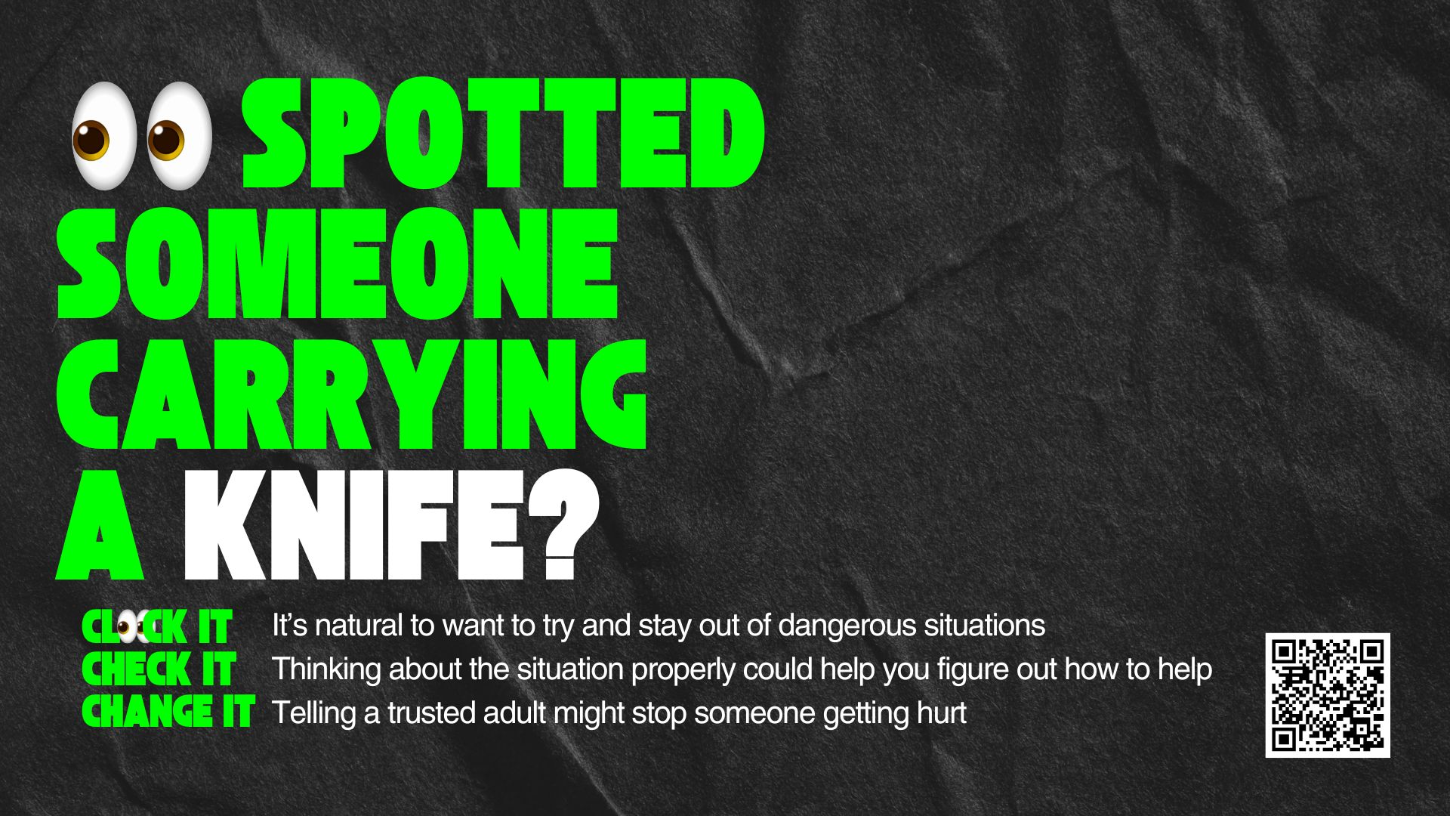

Clock it, Check it Change it Assets
Asset | Size
Landscape digital display | 1920 x 1080

Slide 12
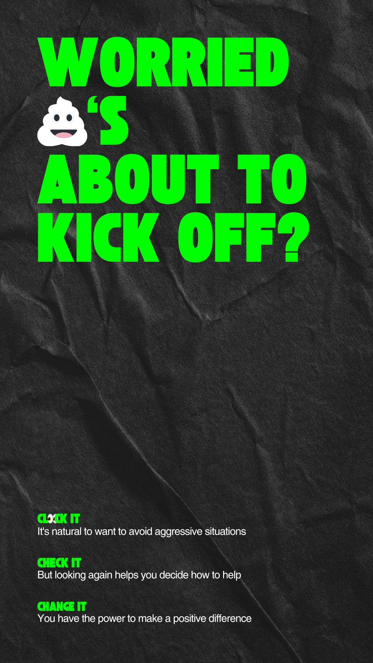
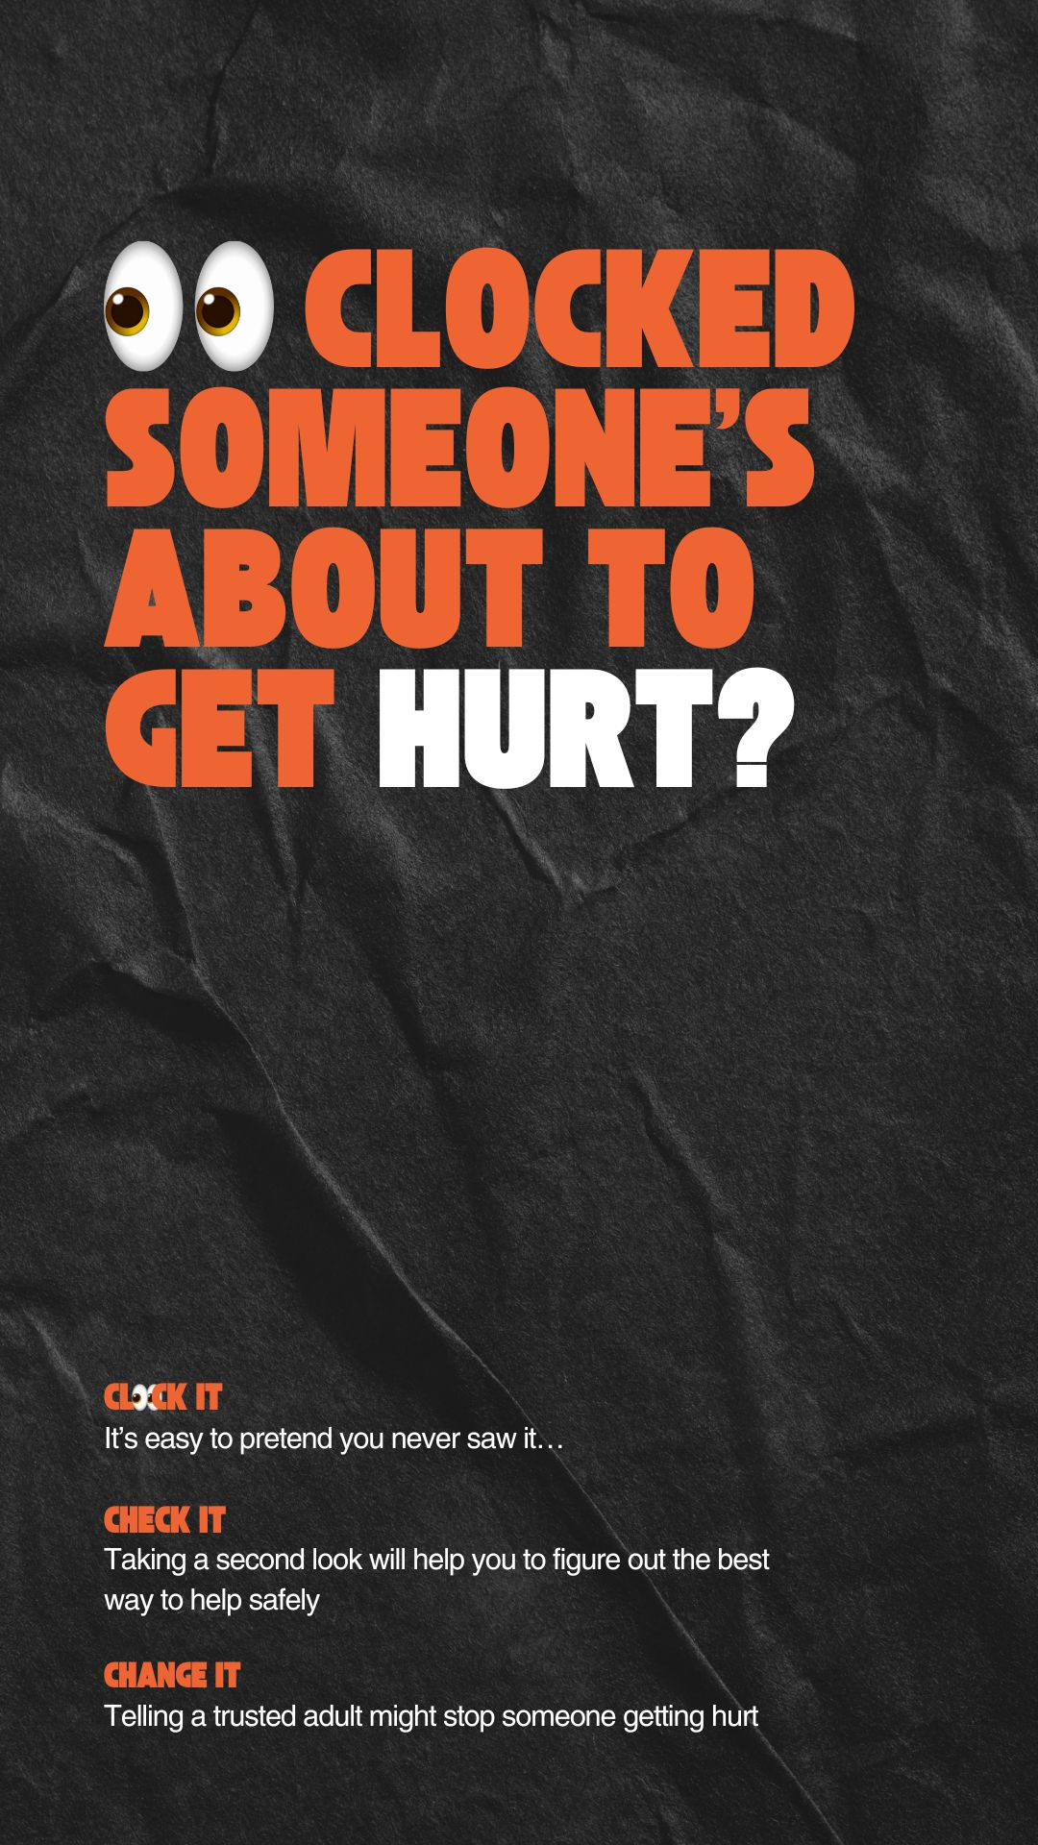
Clock it, Check it Change it Assets
Asset | Size
Portrait digital display or vertical social media (e.g. Instagram stories) | 1080 x 1920

Slide 13
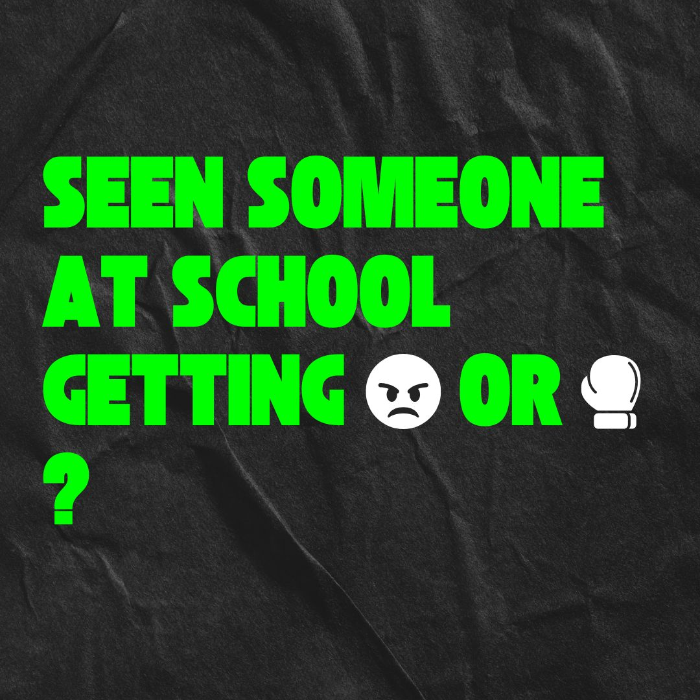
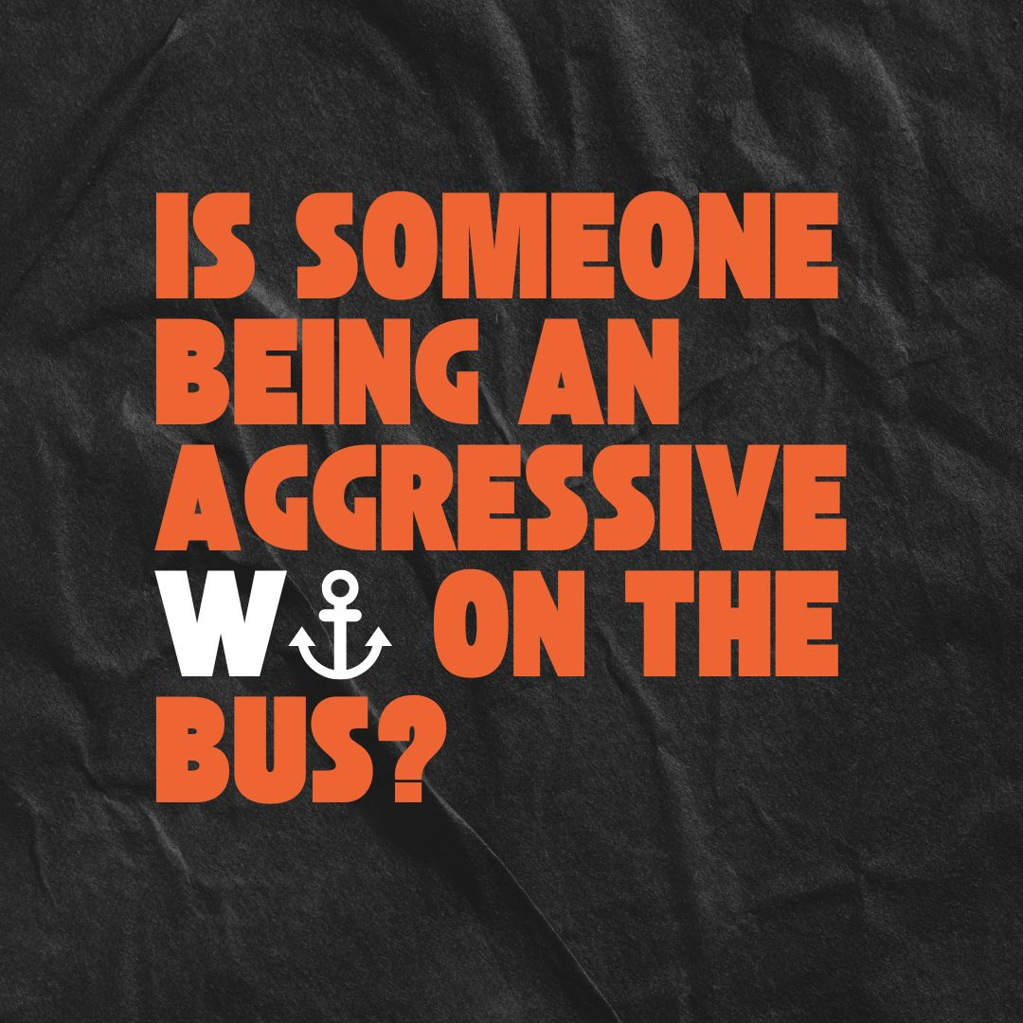
Clock it, Check it Change it Assets
Asset | Size
Square digital for social media platforms | 1080 x 1080

Slide 14
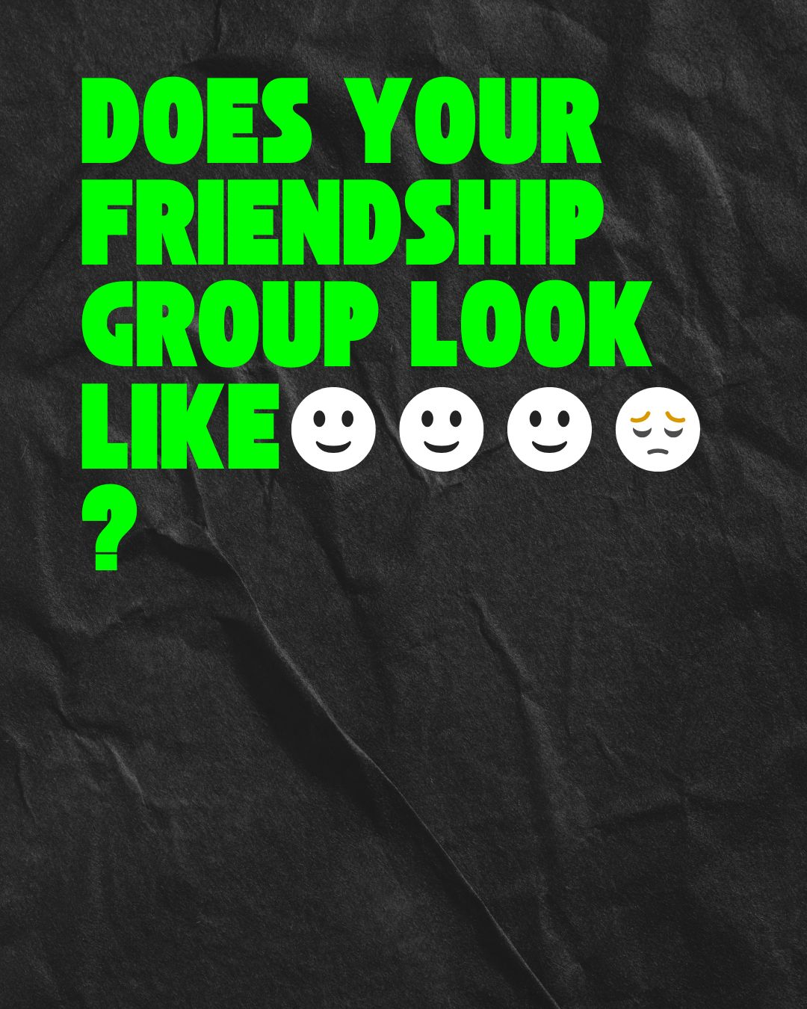
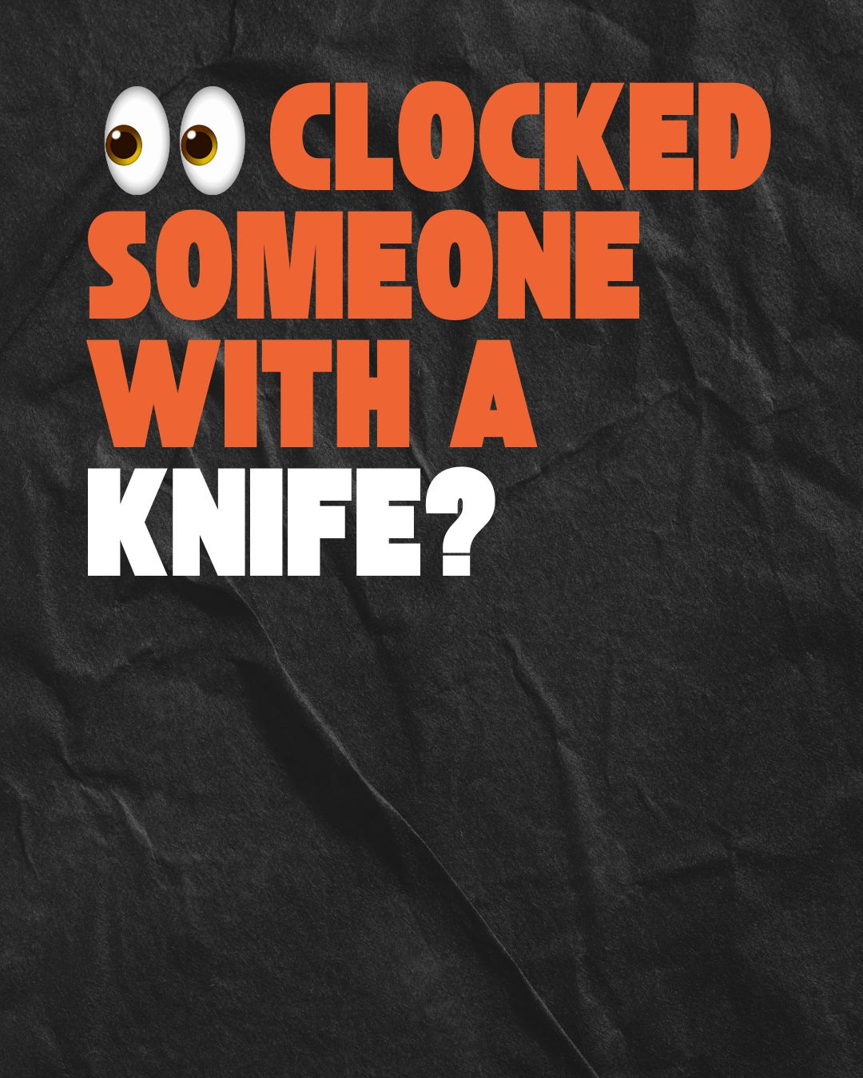
Clock it, Check it Change it Assets
Asset | Size
Portrait social media / digital | 4:5

Slide 15
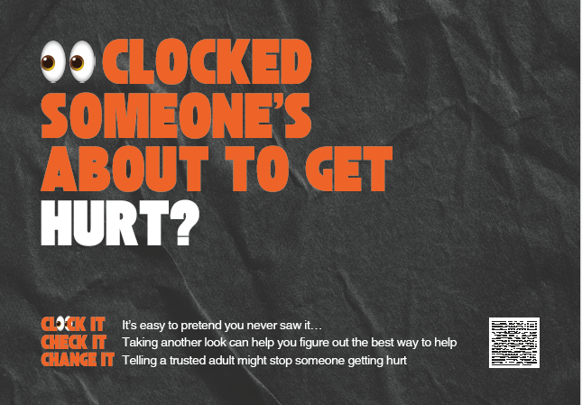
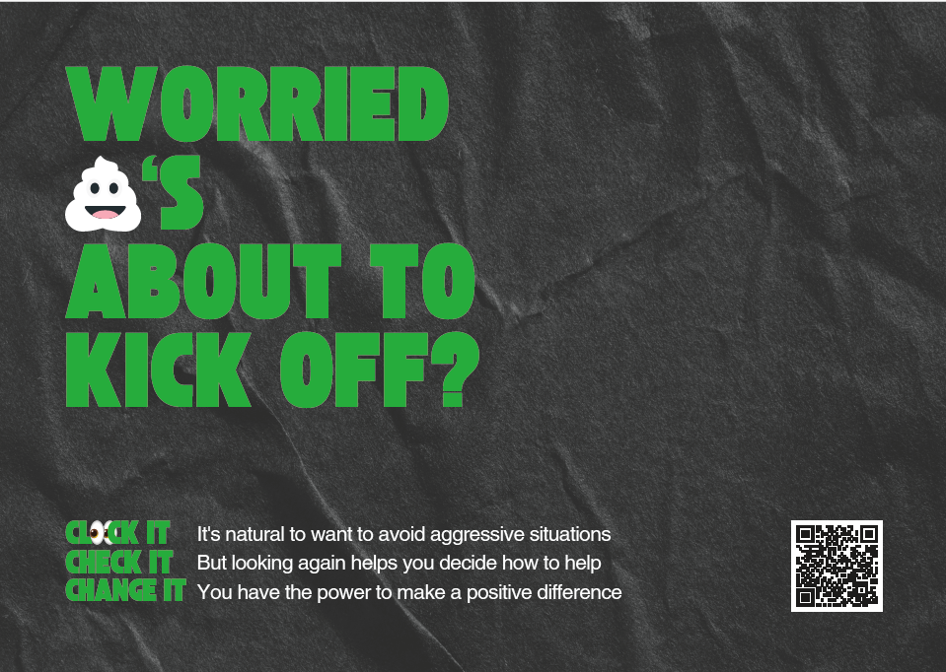
Clock it, Check it Change it Assets
Asset | Size
A4 print ready posters | 210mm x 297mm landscape

Slide 16
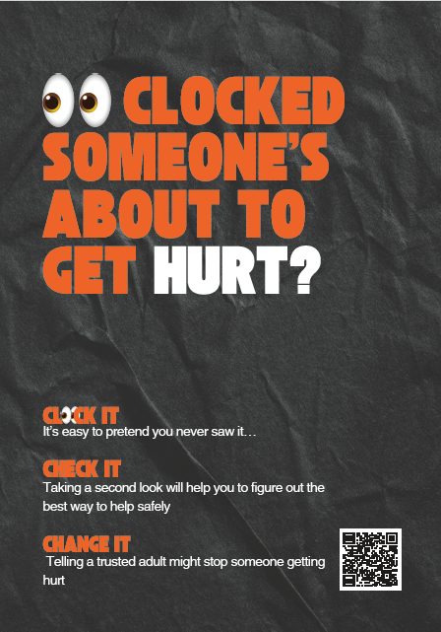
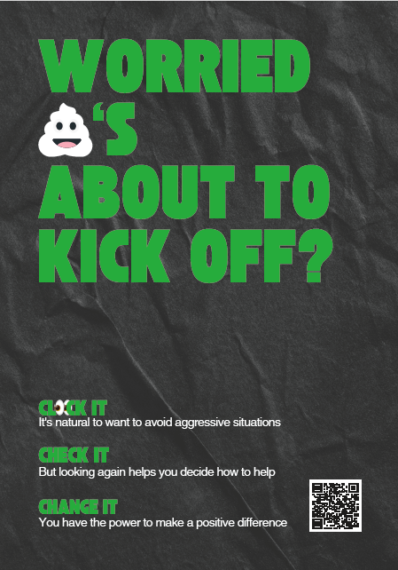
Clock it, Check it Change it Assets
Asset | Size
A4 print ready posters | 297mm x 210mm

Slide 17
Key messages
General examples (suited for older teens / young adults) - long copy (best for use in animations)
 | Generic | Violent behaviour | Partner abuse | Knife crime
Example hook | Worried 💩 is about to kick off? | Is someone being an aggressive W⚓ on the bus? | Is your mate being a 🔔🔚 towards his partner? | 👀 clocked someone with a knife?
Clock it | If you see unacceptable behaviour, it’s natural to want to look away | Fight the urge to turn up your headphones and block it out | It’s easy to ignore the signs of domestic abuse | Spotted a knife on someone? It’s easy to pretend you never saw it…
Check it | But taking another look can give you the chance to figure out how to help safely | Assessing the situation will give you time to think about safe ways to stop things escalating | Assessing the situation rather than avoiding it could help you figure out how to help | Taking a second look will help you to figure out the best way to help safely – such as reporting them anonymously to the police
Change it | Act with confidence – you have the power to make a positive difference | A simple positive action like asking someone if they’re okay could be enough to avoid them getting hurt | A simple positive action like asking someone if they’re okay could be enough to avoid them getting hurt | Your actions can help reduce the deadly threat of knife crime

Slide 18
Key messages
General examples (suited for older teens / young adults) - short copy (best for use on posters or other static assets)
 | Generic | Violent behaviour | Partner abuse | Knife crime
Example hook | Worried 💩 is about to kick off? | Is someone being an aggressive W⚓ on the bus? | Is your mate being a 🔔🔚 towards his partner? | 👀 clocked someone with a knife?
Clock it | It's natural to want to avoid aggressive situations | Take another look | It’s easy to ignore the signs of domestic abuse | It’s easy to pretend you never saw it…
Check it | But looking again helps you decide how to help | Give yourself a chance to decide how to help | Taking a proper look at the situation lets you figure out how to help | Taking a second look will help you to figure out the best way to help safely
Change it | You have the power to make a positive difference | Your words and actions can make a difference | Your words and actions can make a difference | Your words and actions could save a life

Slide 19
Key messages
Teenager scenarios - long copy (best for use in animations)
 | Generic | Friendships | Bullying | Weapons | Relationships | Violence/abuse
Example hook 1 | Clocked someone’s about to get hurt? | Does your friendship group look like 🙂🙂🙂🙂😥? | 👀spotted someone being bullied? | 👀spotted someone carrying a knife? | 👀something off with your friend’s relationship? | Seen someone at school getting 🤬 or 🥊?
Clock it | We all want to stay away from violence | It’s easy to ignore someone getting picked on | If you see someone being bullied, it’s natural to want to avoid the situation | It’s natural to want to try and stay out of dangerous situations | It’s easy to ignore the signs of an abusive relationship | It’s natural to try and ignore unacceptable behaviour
Check it | But taking another look could help you to figure out how to help safely | But thinking about the situation could help you figure out how to help | But taking another look could give you the chance to figure out how to help them | But thinking about what you’ve heard could help you figure out how to help | But thinking about the situation could help you figure out how to help | But taking another look could help you to figure out how to help safely
Change it | Telling an adult you trust might stop someone getting hurt | Telling an adult you trust might stop someone getting hurt | Telling an adult you trust might stop someone getting hurt | Telling an adult you trust might stop someone getting hurt | Telling an adult you trust might stop someone getting hurt | Telling an adult you trust might stop someone getting hurt

Slide 20
Key messages
Teenager scenarios – short copy (best for use on posters)
 | Generic | Friendships | Bullying | Weapons | Relationships | Violence/abuse
Example hook 1 | Clocked someone’s about to get hurt? | Does your friendship group look like 🙂🙂🙂🙂😥? | 👀spotted someone being bullied? | 👀spotted someone carrying a knife? | 👀something off with your friend’s relationship? | Seen someone at school getting 🤬 or 🥊?
Clock it | It’s natural to try and ignore it | It’s easy to ignore someone getting picked on | It’s natural to not want to get involved | It’s natural to want to try and stay out of dangerous situations | It’s easy to ignore the signs of an abusive relationship | It’s natural to try and ignore unacceptable behaviour
Check it | Taking another look could help you figure out how to help safely | Thinking about the situation could help you figure out how to help | Taking another look could help you figure out how to help them | Thinking about the situation properly could help you figure out how to help | Thinking about the situation could help you figure out how to help | Taking another look could help you to figure out how to help safely
Change it | Telling an adult you trust might stop someone getting hurt | Telling an adult you trust might stop someone getting hurt | Telling an adult you trust might stop someone getting hurt | Telling an adult you trust might stop someone getting hurt | Telling an adult you trust might stop someone getting hurt | Telling an adult you trust might stop someone getting hurt

Slide 21
Thank you

